Slide 1
Mohammadmahdi Ghahramani
Vision and Cognitive Systems Project
Professor: Lamberto Ballan
Topic: Modeling temporal dynamics and spatial configurations of actions using
recurrent neural networks and self-attention gates
University of Padova, Academic Year 2021/22
https://github.com/MohammadMahdiGhahramani7/Computer_Vision_Course_Project

Slide 2
Human Activity Recognition
Activity recognition aims to recognize the actions and goals of one or more agents from a series of observations on the agents' actions and the environmental conditions. [Wikipedia]
Approaches:
- RGB videos captured
- Skeleton-based action recognition

Slide 3
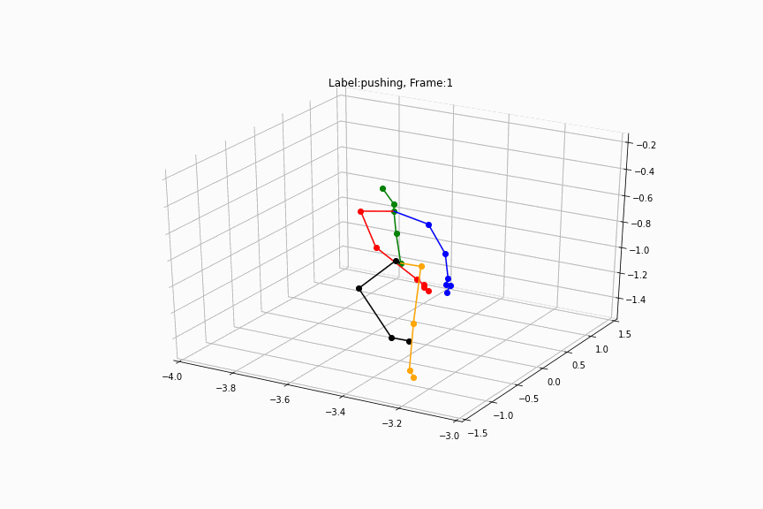
Skeleton-based Action Recognition
By dividing the body into five parts and recombining them together, this organizational structure shifts the focus of the model to the part of the body that performs the majority of the activity.

Slide 4
Introduction, Why Skeleton-based Approach?
Cost-effective
Improvement in the accuracy of depth detection sensors and cameras.
Disadvantages of RGB-based video processing:
c1) High-dimensional and low-quality input data are difficult to well extract.
c2) RGB video can be very sensitive to factors like illumination changes, occlusion, and clutter in the background.
c3) Identifying actions requires high-level visual clues such as human poses and objects.

Slide 5
Introduction, Dataset
In this research, the NTU RGB+D is used in order to evaluate the model performance. There are two versions of this dataset, the first one with 120 labels and the second one with 60 labels. The second dataset has about 54000 data samples, i.e. about 900 data samples per label.

Slide 6
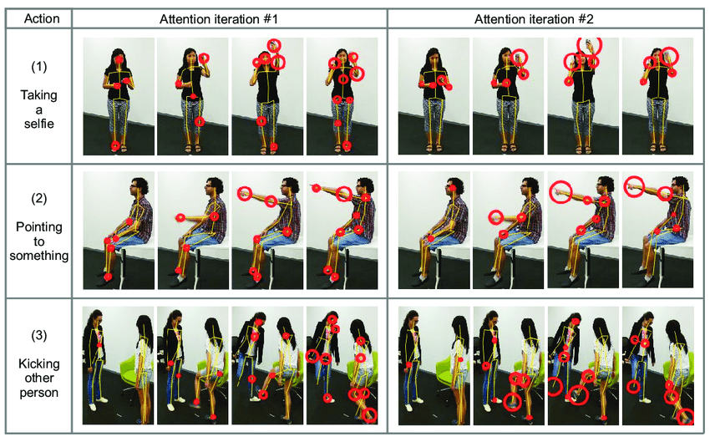
Introduction, Dataset
[Source]

Slide 7
Introduction, Method
A number of detailed coordinates are stored over a period of time. The order of all this data is important in achieving the result. However, if we are careful, we will find that not all data is always stored this way, and our data collection system may be unreliable. These noises reduce the accuracy of the diagnosis. Also, when it comes to recognizing human activity, there may be movements that focus only on one part of the body, such as shaking hands, which is the most common change in the joints of the arm and hand, and the lower extremities do not change or have very little change.

Slide 8
Introduction, Method
This research decided to use the attention mechanism and a unique hierarchical structure. The attention mechanism handles noise and distortion data, and the hierarchical structure makes the network focus entirely on the part where the changes are taking place. This structure Hierarchy is in fact responsible for paying attention to the spatial domain.

Slide 9
Introduction, Federated Learning
Federated learning enables multiple actors to build a common, robust machine learning model without sharing data, thus allowing to address critical issues such as data privacy, data security, data access rights and access to heterogeneous data. Since this kind of learning does not manipulate the main structure of the model, the performance of the model is not expected to change. In other words, after bringing the model into this environment we do not expect the accuracy to increase or decrease.

Slide 10
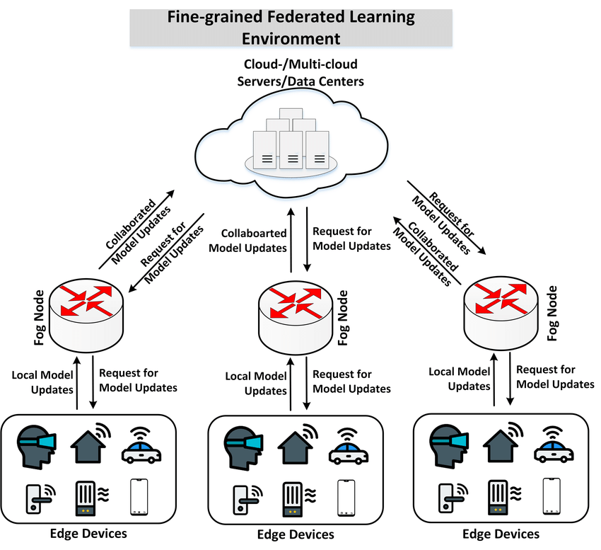
Introduction, Federated Learning
[Source]

Slide 11
Introduction, Model Checking and Results
The performance of the trained model is evaluated using 400 data samples. These sample are distributed fairly in different 20 categories. The accuracy provided by this model is 80.5% on unseen data. By model checking, this research means the wrongly-labeled data should not be too different from the concept of their true labels.

Slide 12
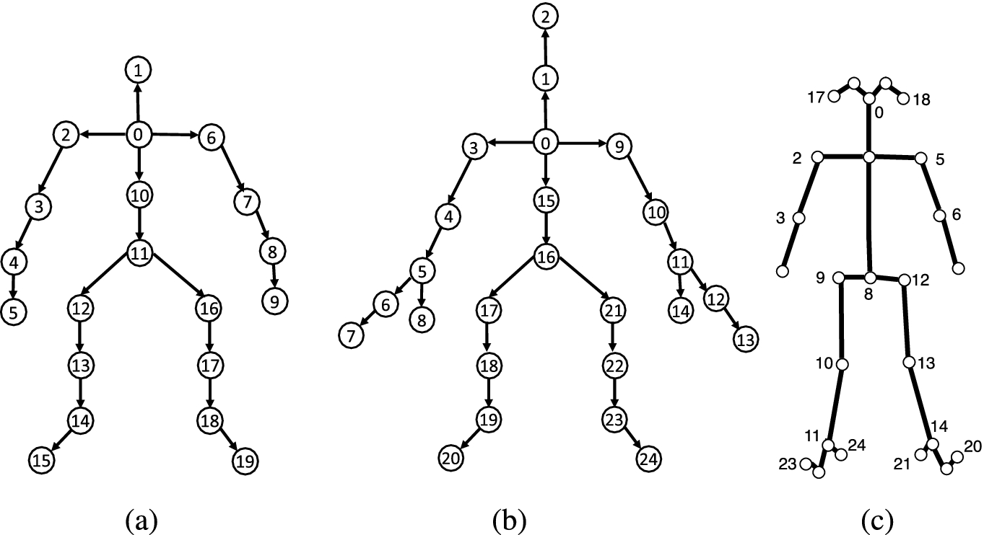
Dataset, NTU RGB+D
[Source]

Slide 13
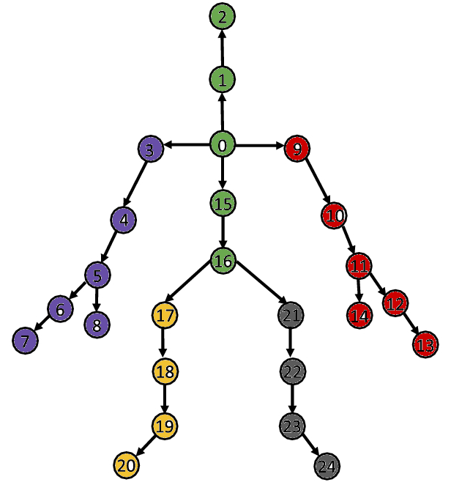
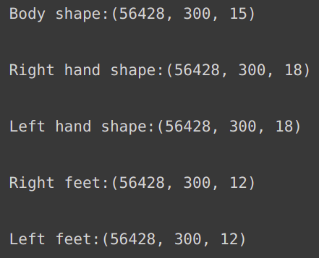
Dataset, NTU RGB+D

Slide 14
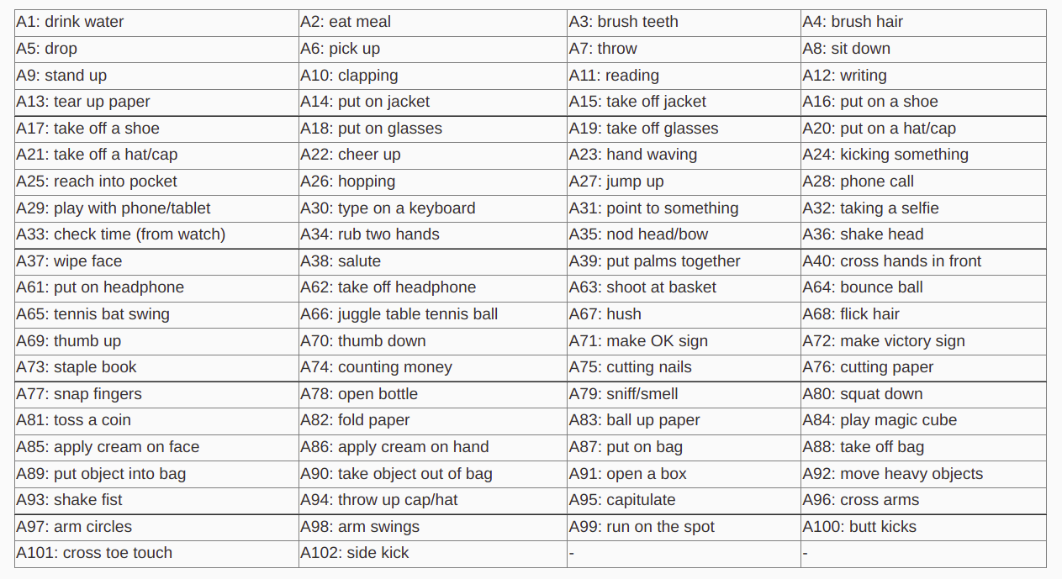
Dataset, NTU RGB+D
[Source]

Slide 15
Dataset, Visualization
The study also provides a visual representation of the results. We need to check how different wrong-labeled data are from their original labels to ensure that the model is working fairly well. It means that the model has not yet trained properly if it labels data whose real label is brush-hair as jumping. Alternatively, if the model misclassifies this data as brush-teeth, this error is meaningful since these two tasks are much more similar than jumping. This dataset, however, does not provide us with well-formed data that is easy to visualize. This study provides a gif-based visualization of the results by manipulating the input and applying several algebraic transformations.

Slide 16
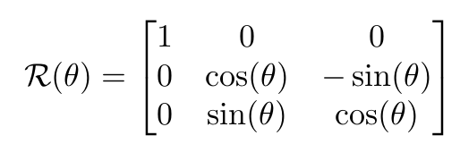
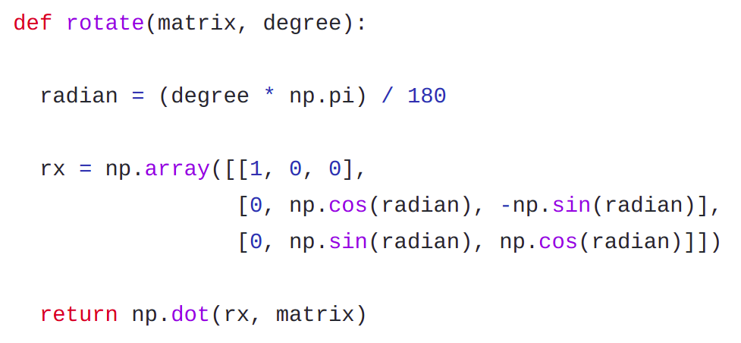
Dataset, Visualization-Rotation

Slide 17
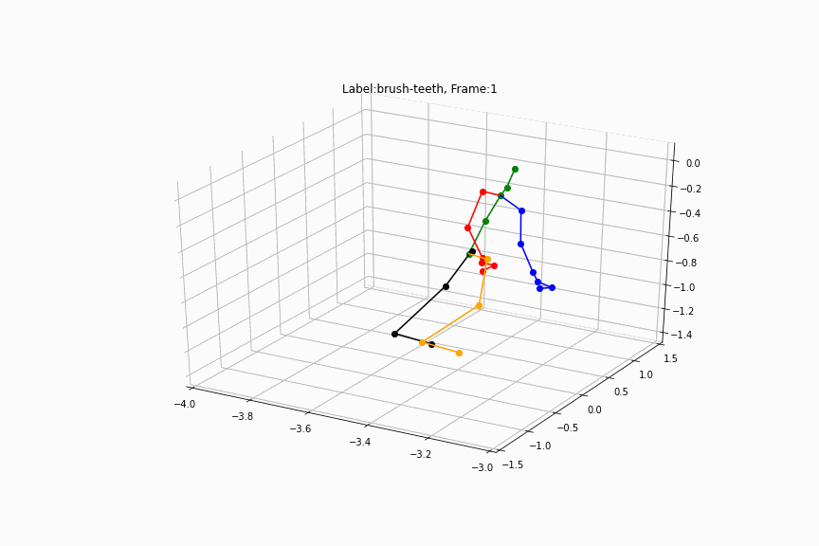
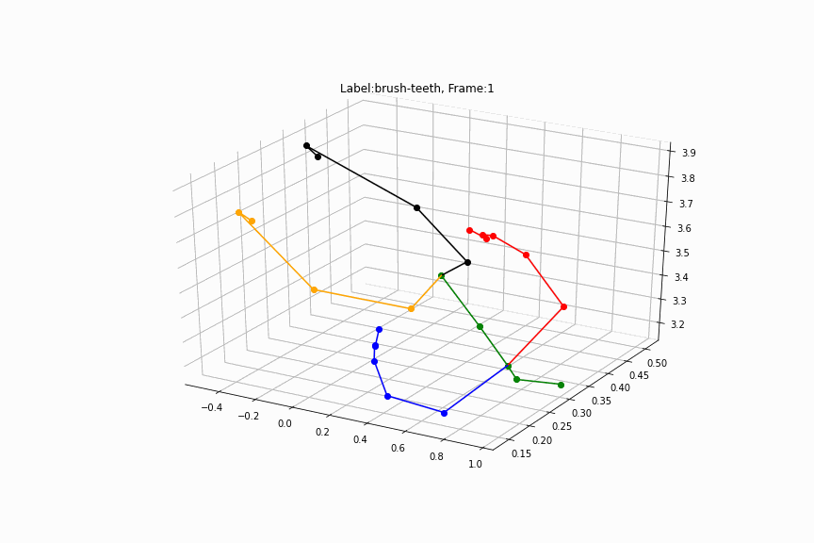
Dataset, Visualization-Rotation

Slide 18
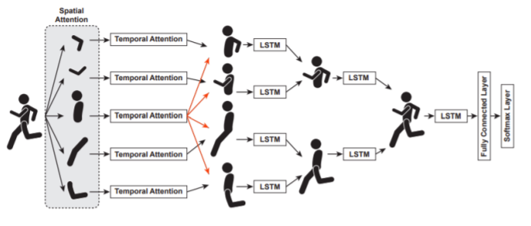
Method
First-part: Attention Mechanism Second-part: Hierarchical Structure

Slide 19
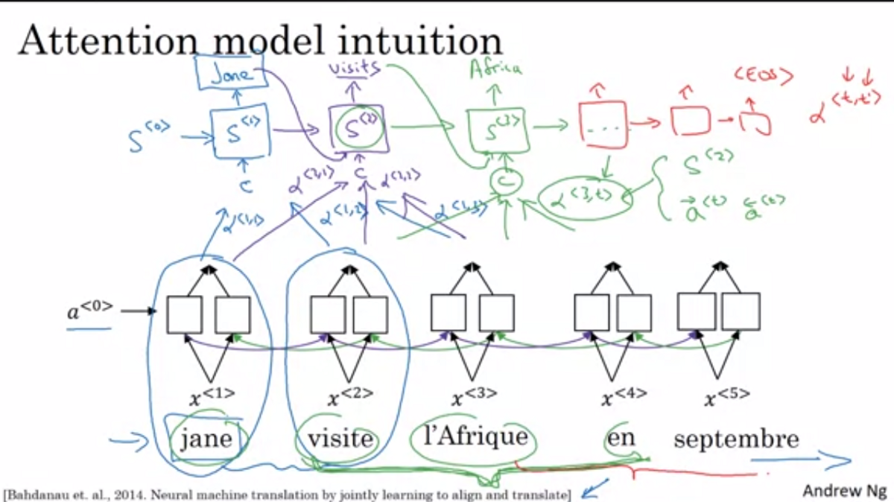
Method, Attention Mechanism, Intuition
[Source]

Slide 20
Method, Attention Mechanism
The use of self-attention gates has played an important role in the development of activity detection. But so far, most of the gates designed are made of neural networks themselves which have problems such as gradient vanishing or gradient explosion. Therefore, in this approach, we use an attention mechanism that uses a conversion system instead of neural networks. This method consists of two parts: encoder and decoder.

Slide 21
Method, Attention Mechanism
An attention self component with n inputs will include n outputs. Simply put, this component allows inputs to interact with each other and decide which input to pay more attention to. In fact, the output is the attention score of each input. The temporal space gate in this method consists of a self-attention gate and an LSTM layer that we are already familiar with. In fact, the output of the attention self gate is considered as an input to LSTM layer.

Slide 22
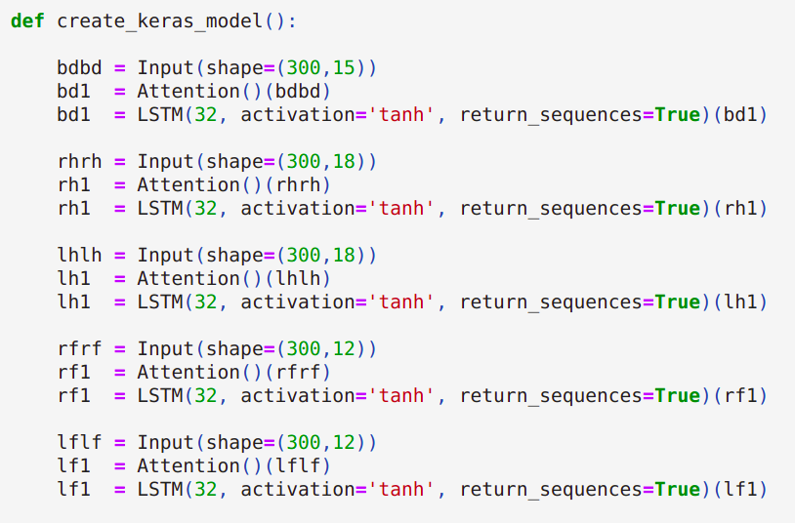
Method, Attention Mechanism

Slide 23
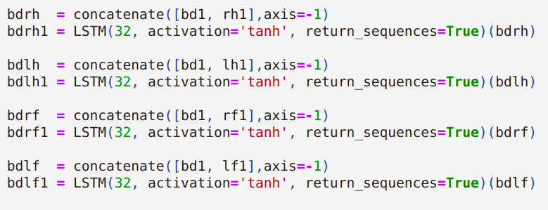
Method, Concatenating

Slide 24
Method, Hierarchical Structure
The skeleton data has a lot of flexibility. This allows them to be separated. In this study, the human skeleton is divided into five parts: the right hand, left hand, body, right foot, and left foot. The purpose of diversification is to increase the network’s focus on parts in a specialized manner. As a result of this division, we have 5 sets of data as inputs to the network. Our goal is to finally restore this split skeleton to its original form

Slide 25
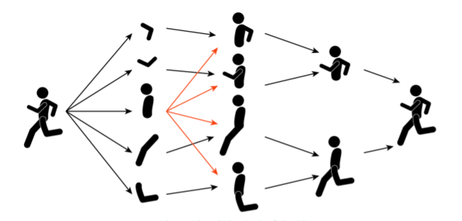
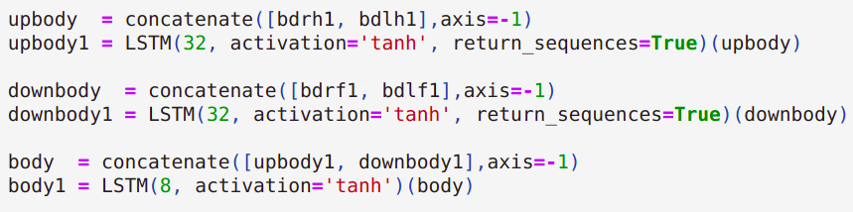
Method, Hierarchical Structure
By combining the right and left torsos, the upper and lower skeletons are made, and finally, by combining the upper and lower torsos we get the final skeleton.

Slide 26
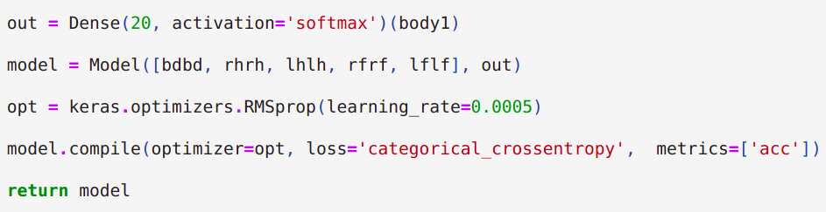
Method, Dense layer and Softmax activator

Slide 27
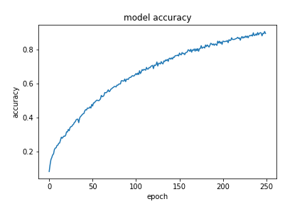
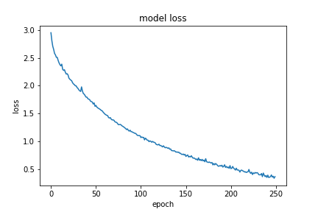
Model Training, Hold-out Approach
Training set 70%
Validation set 20%
Training set + Validation set 90%
Test set 10%

Slide 28
Model Training, Stochastic fine tuning
Trial and error by:
Accuracy -> Model performance
Result visualization -> Meaningfulness

Slide 29
Federated Learning
As the final step, this study reviews how to provide a federated space to learn the model using decentralized clients. Federated learning enables multiple actors to build a common, robust machine learning model without sharing data, thus allowing to address critical issues such as data privacy, data security, data access rights and access to heterogeneous data.

Slide 30
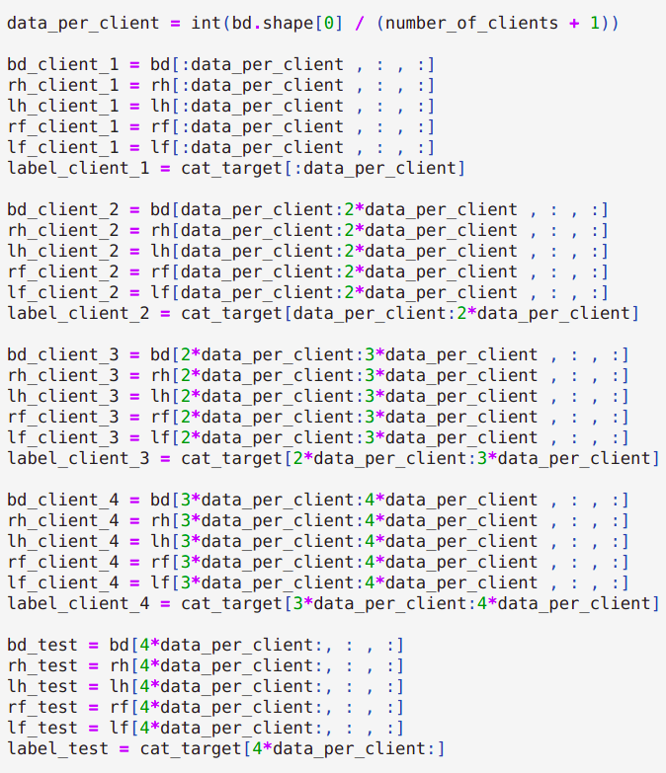
Federated Learning
Federated Data =>

Slide 31
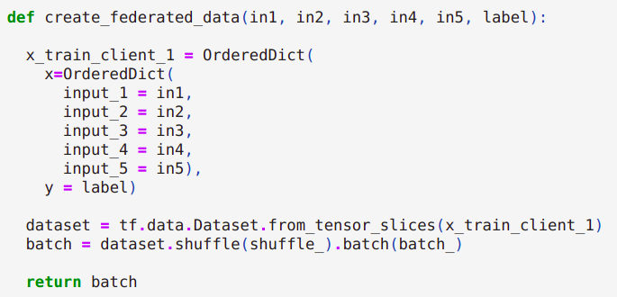
Federated Learning
Federated Data =>

Slide 32
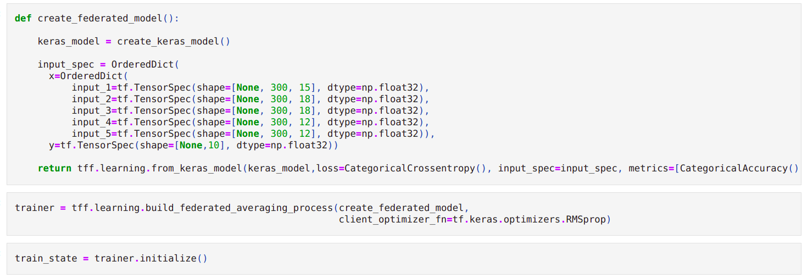
Federated Learning, Model

Slide 33

Resources
All the training process and fine tuning of the model has been performed on the Colab environment which let us use limited GPU to train the model. Even having GPU, one attempt to train the model with 250 epochs takes approximately 100 minutes.

Slide 34
Results, Model Performance (Accuracy)
The performance of the trained model is evaluated using 400 data samples. These sample are distributed fairly in different 20 categories. The accuracy provided by this model is 80.5% on unseen data. By consistently reviewing the result and compare the similarity between wrong-labeled data samples to their original labels and then adjusting the model structure, the model is capable to provide this number of accuracy.

Slide 35
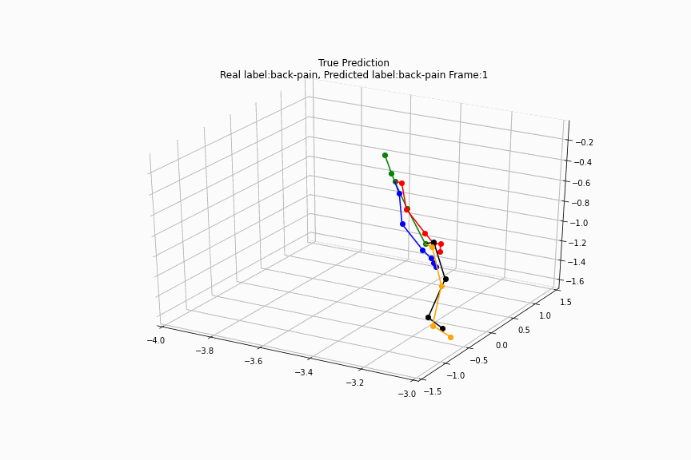
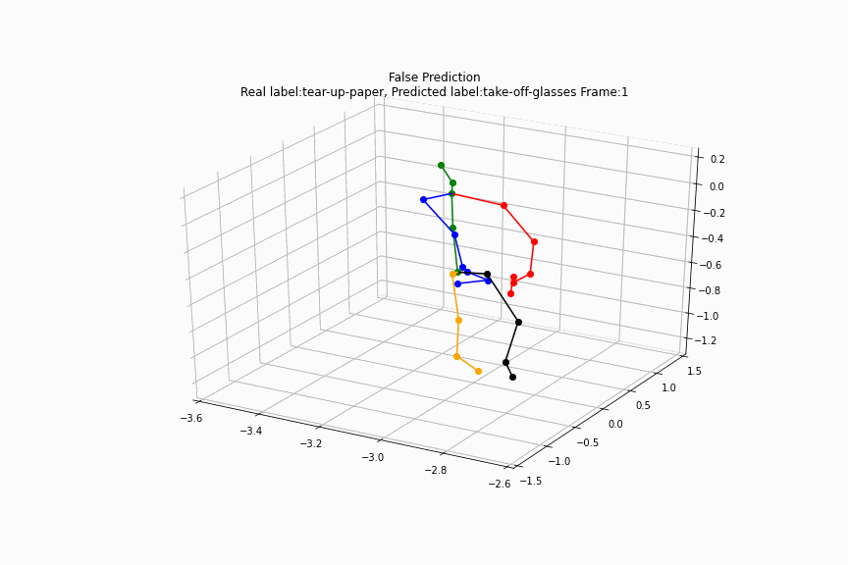
Results, Model Meaningfulness

Slide 36
Further Research
Systematic fine tuning process
Lack of a mechanism to announce the starting point of an activity and its end

Slide 37

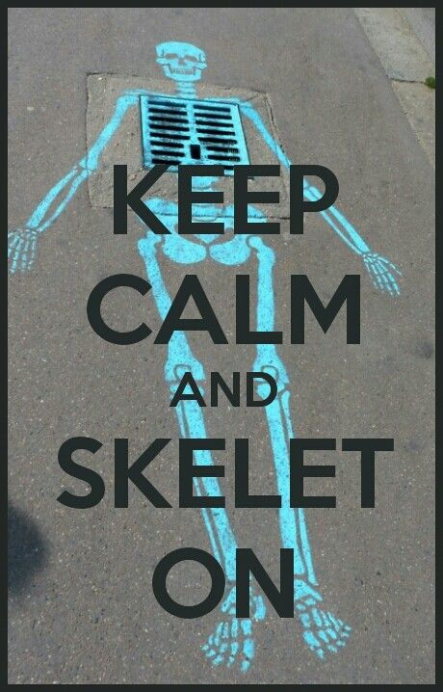
Thanks For Your Attention

